Slide 1
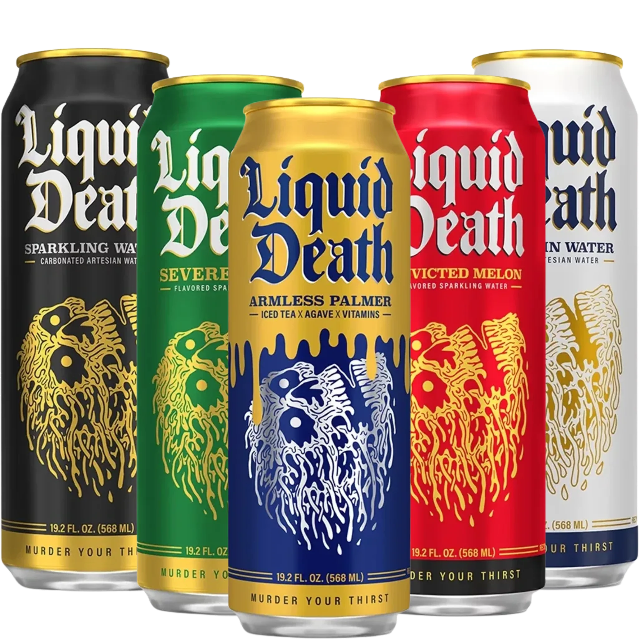
Liquid Death

Slide 2
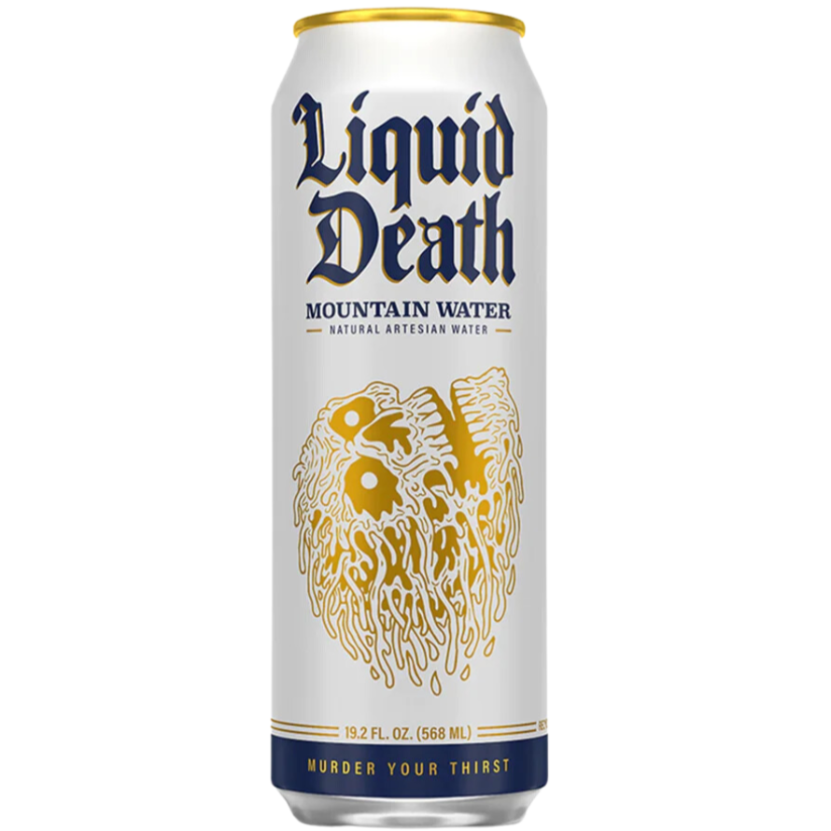
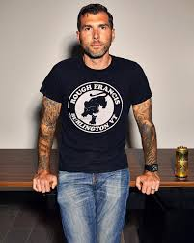
Company Overview
Founded: 2017 by CEO Mike Cessario in Santa Monica, California
8th most followed beverage brand on social media
Raised nearly $50 million in investment funding
Unique positioning: Anti-Corporate, uses aluminum cans instead of plastic, limited advertising

Slide 3
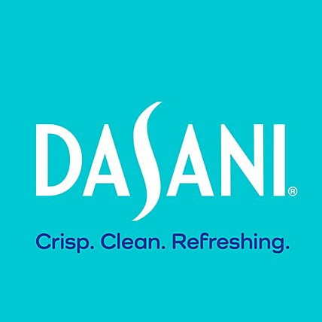
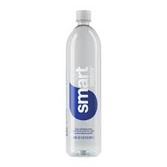
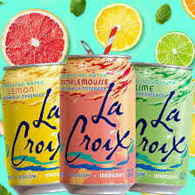
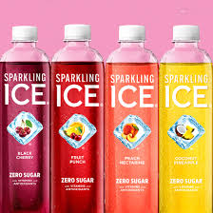
Competitive Landscape
Direct Competitors: Dasani, SmartWater, Sparkling Ice, and LaCroix
Indirect Competitors: Corona and Heineken
Competitive Advantages
Stands out from traditional water brands
Sustainable aluminium packaging

Slide 4
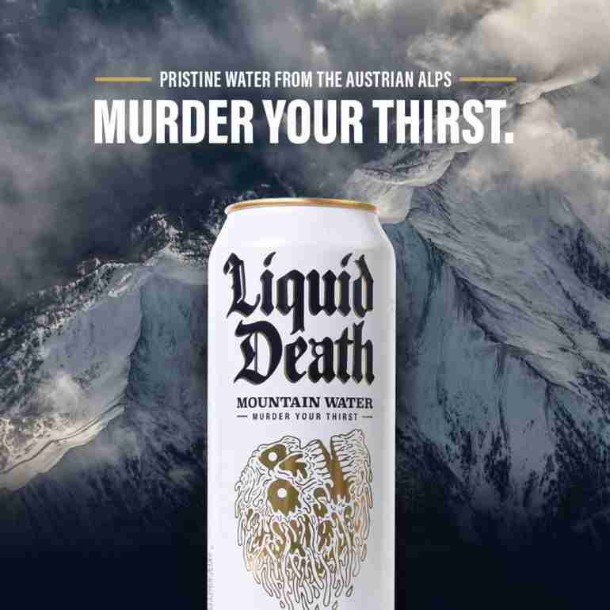
Target Customers
Primary Audience: Gen Z & Millennials
Key Motivations
Drawn to sustainability efforts
Support authentic brands fighting against corporate greenwashing
Market Approach
Uses modern slang & humor
“Murder Your Thirst”
Strong Social Media Presence
Engages audiences with unconventional marketing campaigns and interactive content
Notes:
Value sustainability and edgy or unconventional practices
They are tired of fake brands and want to feel like they are making a difference,
Liquid death offers customers a chance to be a part of the movement towards fighting the system
sustainable aluminum cans and “death to plastic” mentality

Slide 5
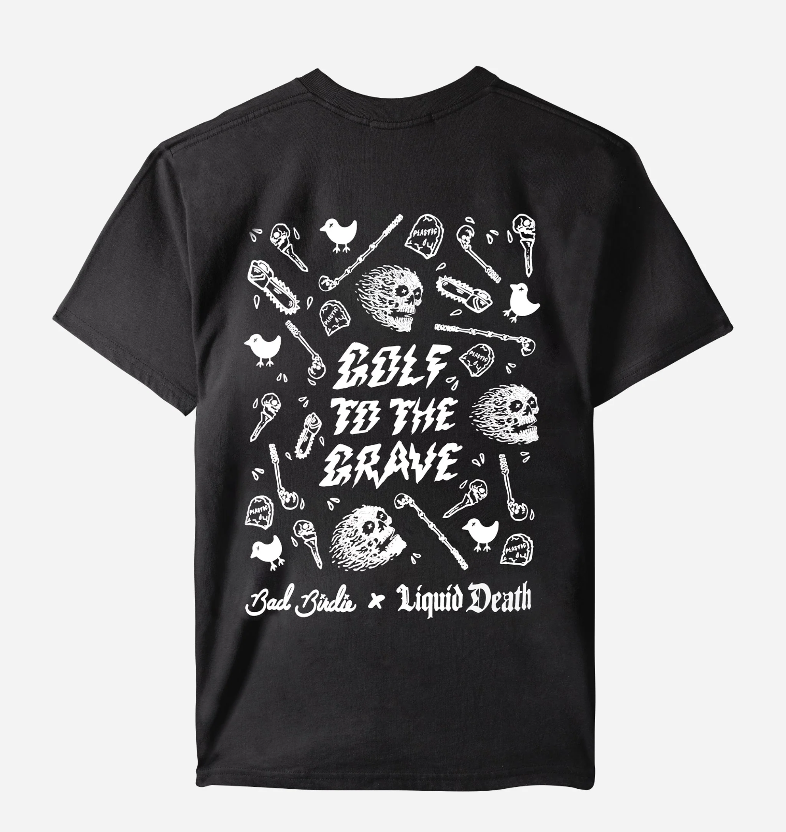
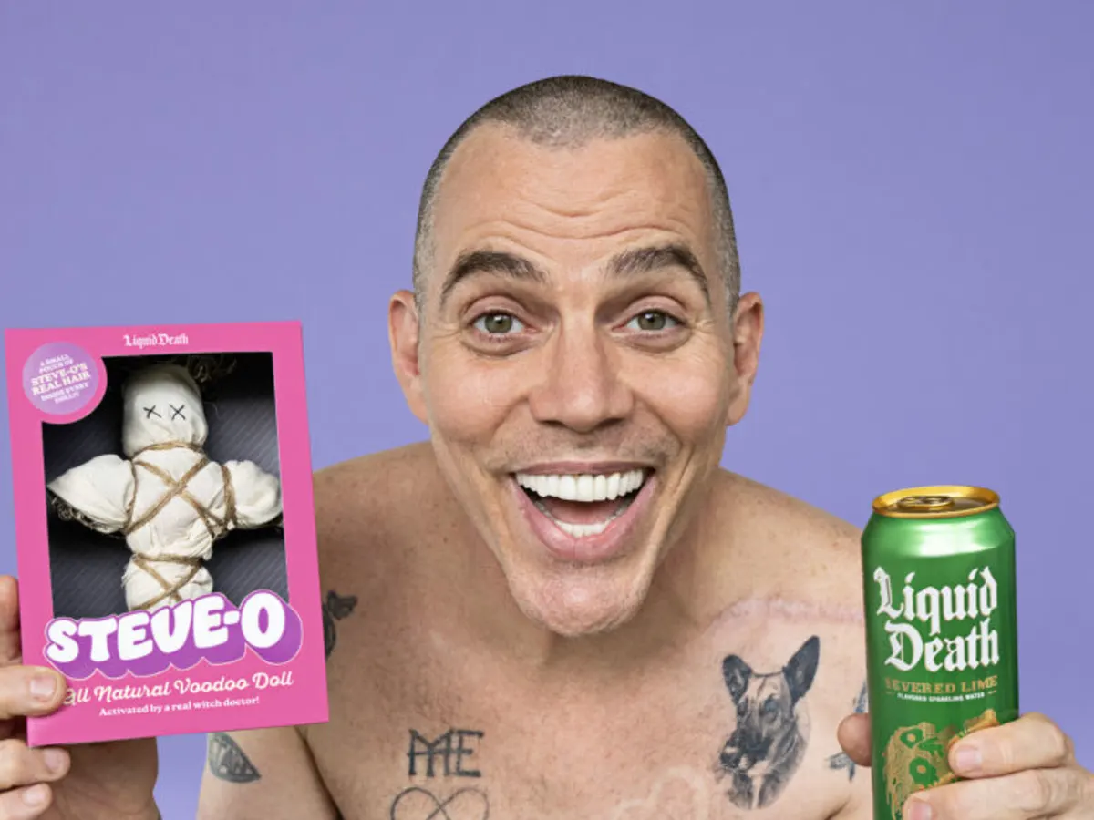
Collaborations & Partnerships
Suppliers and Distributors
Supplying Demand Inc. (Internal)
Mountain Water
Wilderness Asset Holding LLC
Aluminum Cans
Aalco, Chesapeake, Straub Distributing
Partnerships
Steve-O
Voodoo Doll
Tony Hawk
Skateboard with infused blood
Bad Birdie
Disruptive apparel
Notes:
Steve O is known for shocking and pain inducing stunts
Completely sustainable voodoo doll made of natural material and steve o hair
Tony hawk might relate a bit more to millennials but he is a beloved skater with a rebellious image
Skateboard had red paint mixed with blood and came with certificate of authenticity
Bad Birdie is committed to pushing boundaries and bring inclusivity in the gold community
Overall: crazy and unique campaigns from a brand that is dedicated to being edgy and unconventional

Slide 6
Market Trends & Environmental Factors
Economic Trends
Regulatory Environment
Revenue: $45m - $130m
Consumer Adoption:
2.5% - 5.5%
Import Tariffs: 10% - 25%
Stricter EPA Rules
Technological Advances
Social Dynamics
Sus & Eco-Friendly Packaging
Biotechnology
Purification Techniques
Thriving Digital Platforms
Cultural Influence
E-Word- of-Mouth

Slide 7
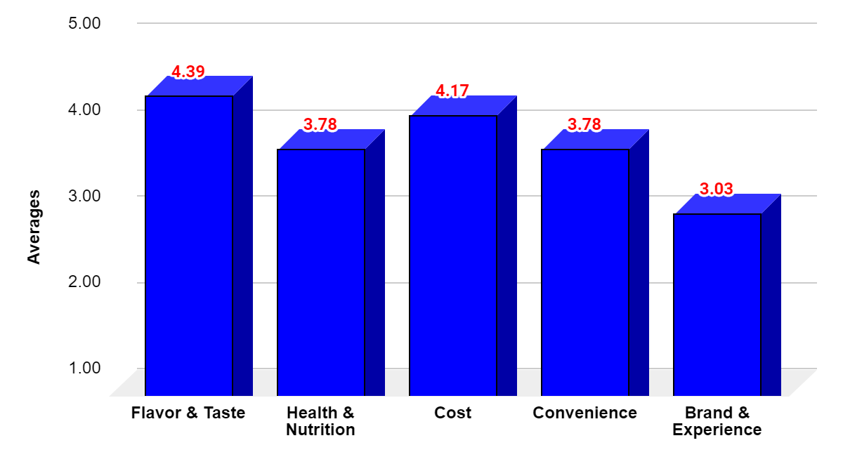
Key Purchase Attributes
Attributes | Source
Flavor & Taste | Geissler & Gamble, 2008; Wright, 2014; An et al.,2022
Health & Nutrition | Wright, 2014; An et al.,2022
Cost | Geissler & Gamble, 2008
Convenience | Wright, 2014
Brand & Experiences | Geissler & Gamble, 2008; Wright, 2014
Figure 1. Average of the Customer Rated Importance of Attributes When Purchasing Bottled Water
Notes:
To further analyze the market performance and positioning strategy of Liquid Death relative to its competitors, we conducted a preference study.
According to previous literature, we have identified five attributes for consumers when selecting bottled water/ sparkling water products. They are…
With 36 valid responses collected, we first examined the average score of the five attributes' importance level. As shown in Figure 1, we can tell that customers prioritize flavor & tastes and cost. Health & nutrition and convenience are equally important while brand name is of less consideration.

Slide 8
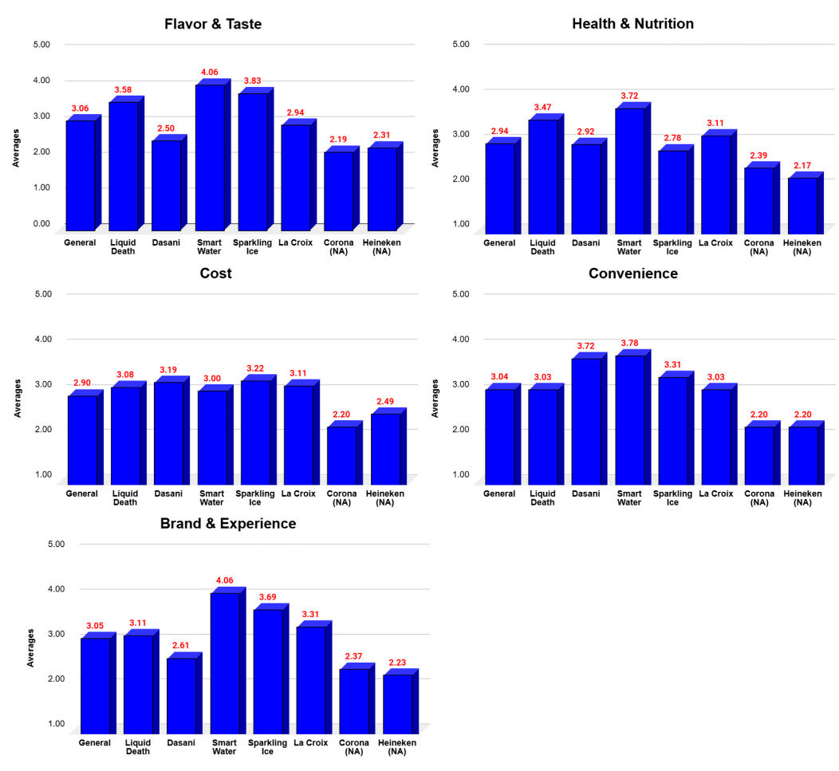
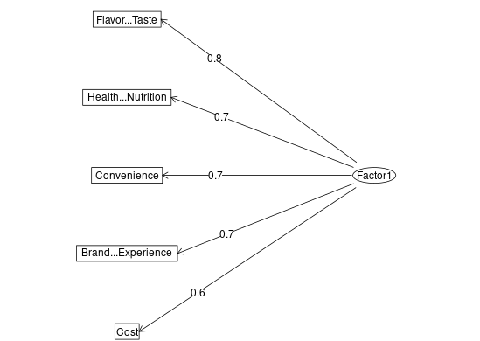
Customer Perception Analysis
Figure 2. Comparison of Customers’ Rating on Liquid Death and Its Competitors Among the Five Attributes
Figure 3. Factor Loading Diagram
***P-value < .001

Slide 9
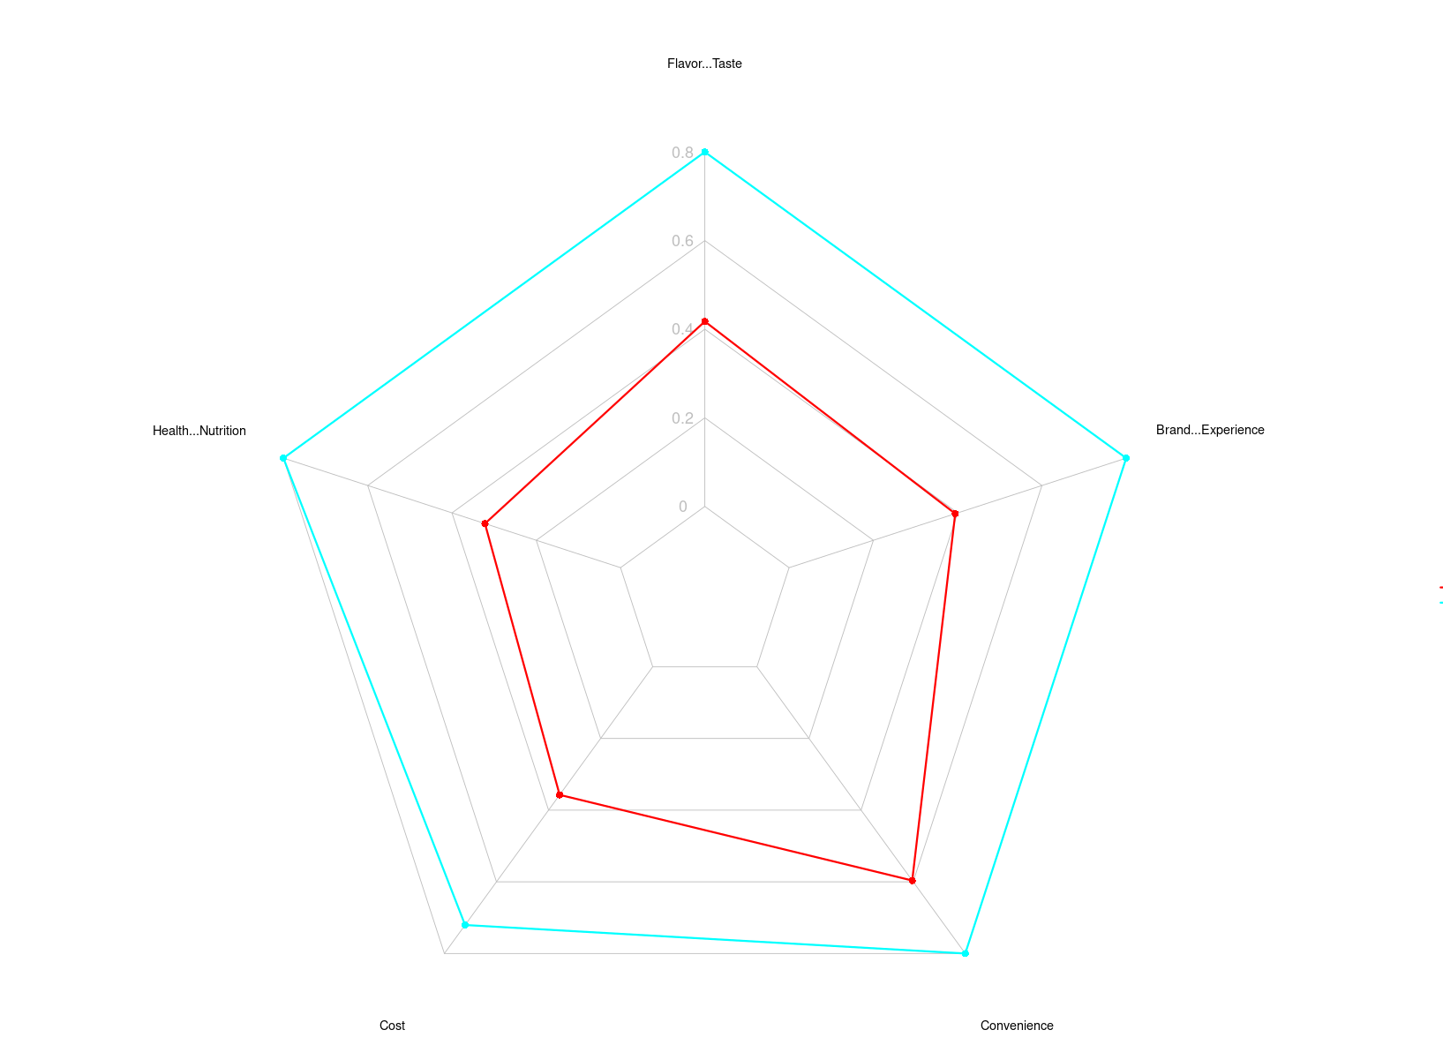
Market Segment Findings
Consumer Preferences in Bottled Water and Sparkling Water Market
Market Segmentation:
Red Cluster: Consumers Prioritizes brand experience, uniqueness, and lifestyle appeal
Blue Cluster: Consumers focusing on taste, health benefits, and convenience
Key Insight:
Clusters reveal different priorities of the consumers (brand vs. functional benefits)
Customer Priorities (Radar Chart Insights):
Leverage brand strength while improving taste perception & convenience

Slide 10
Liquid Death Brand Voice
Branding Strategy: Resonating with Consumers
Target Audience:
Punk Rap Music Fans & Band Enthusiasts:
Nostalgic, "cool" factor that resonates with music culture.
Collaborate with bands, extreme sports, & influencers
Non-Alcohol Consumers at Parties:
Blending in while staying sober.
Introduce new product variants
Partner with health & fitness influencers
Expansion Strategy to Boost Convenience
Increase Retail Presence at Gas stations, airports, concert venues, fitness centers
Optimize e-commerce & direct-to-consumer sales

Slide 11
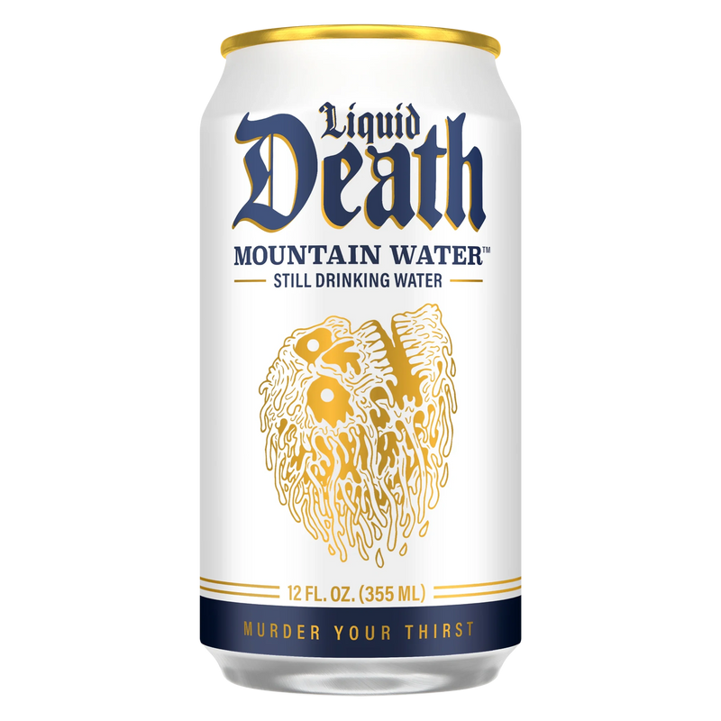
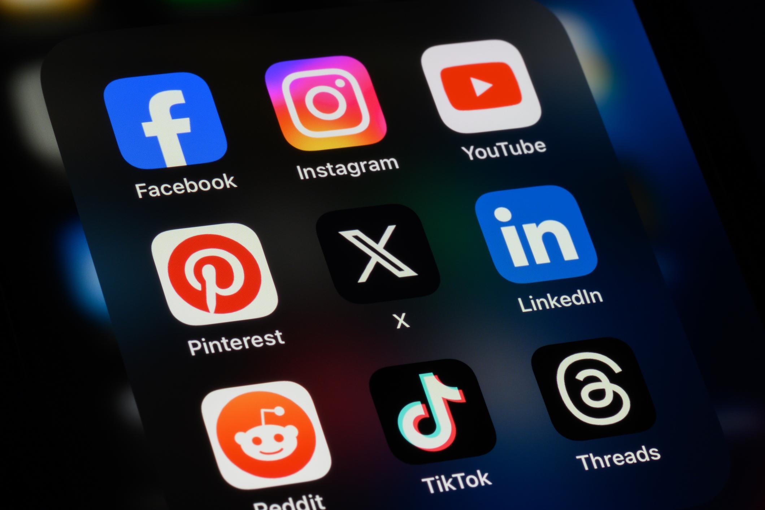
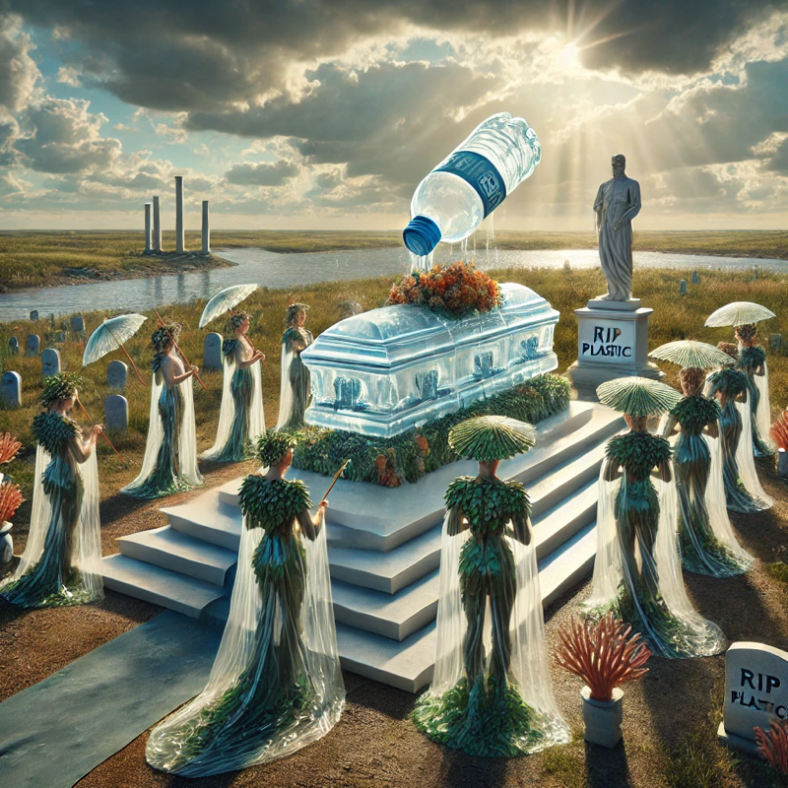
Viral Campaign Ideas
Thirst Murder Trials
“Funeral for Plastic”
Social Media Filters
Notes:
To keep Liquid Death’s momentum going, the brand should continue using bold and unconventional marketing tactics.
One major concept is "Thirst Murder Trials", where users submit the most creative ways to "murder their thirst" with a Liquid Death can—this leverages user-generated content (UGC) to spread brand awareness.
Another idea is interactive filters on platforms like Instagram, Snapchat, and TikTok—turning users’ drinks into a Liquid Death can or having them battle "evil plastic bottles" in a game format.
The "Funeral for Plastic" event takes sustainability activism to another level by staging an actual funeral for plastic bottles, complete with mourners, speeches, and a dramatic sendoff.
The key here is shock value + humor + engagement—Liquid Death thrives when people talk about their outrageous campaigns.

Slide 12

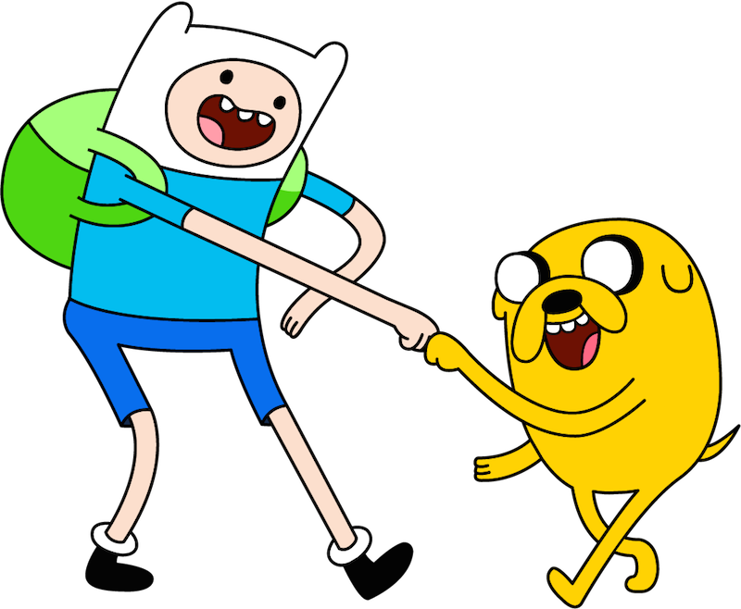
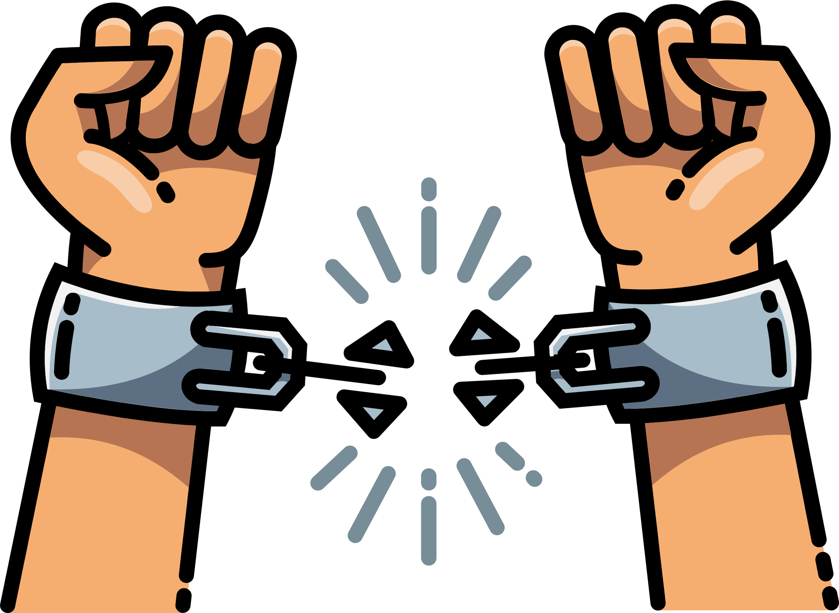
Content & Messaging Strategy
Rebellion
Humor
Sustainability
Notes:
Messaging must stay bold, humorous, and impactful—traditional environmental messaging won’t work for this brand.
Expanding slogans like "Bury Boring Beverages" and "Plastic Bottles Deserve Death" keeps messaging fresh and aligns with Liquid Death’s rebellious personality.
Instead of the typical "Save the Planet" approach, Liquid Death should continue with over-the-top horror-style storytelling, framing plastic as the villain and Liquid Death as the hero.
A great way to do this is through cinematic ads, digital short films, or animated horror-style campaigns where plastic bottles are portrayed as monsters or criminals.
The key takeaway: make sustainability fun, cool, and a movement people actually want to be part of.

Slide 13

Influencer & Brand Collaborations
Comedy, Tattoo Culture, Underground Music
Extreme Sports
Unexpected, Bold, and Subversive
Anti-Corporate & Pro-Sustainability
Notes:
Liquid Death has already collaborated with Tony Hawk, Steve-O, and other edgy personalities to strengthen its brand appeal.
Moving forward, partnerships should expand beyond extreme sports—think comedians, tattoo artists, underground musicians, and alternative fashion brands.
Example: A partnership with a metal band or horror filmmaker to create limited-edition “Blood Water” (red-colored can design) could be a hit.
Influencers on TikTok and YouTube who specialize in dark humor, sustainability, or extreme stunts would also be great brand advocates.
The goal is to keep collaborations unexpected, bold, and subversive, while still aligning with the brand’s anti-corporate, pro-sustainability message.

Slide 14
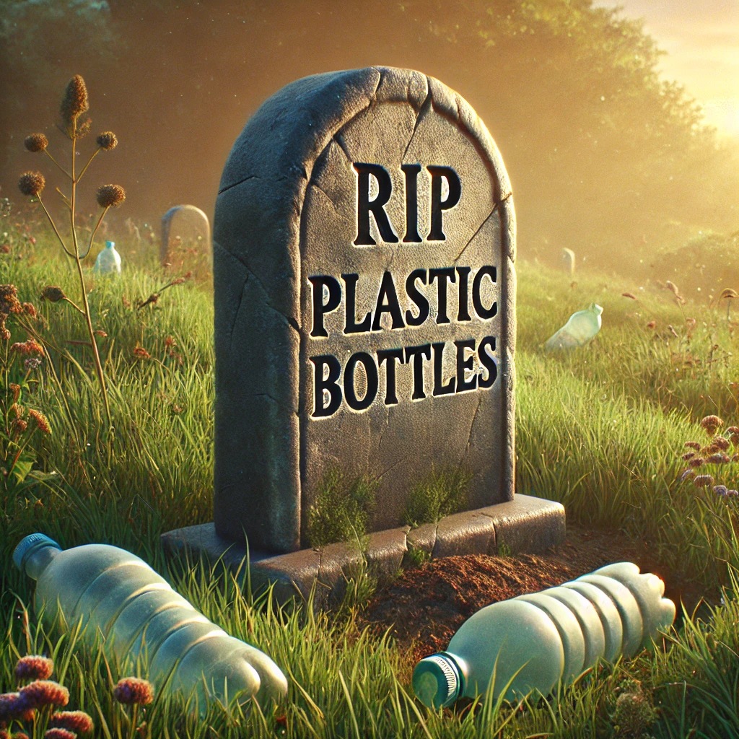
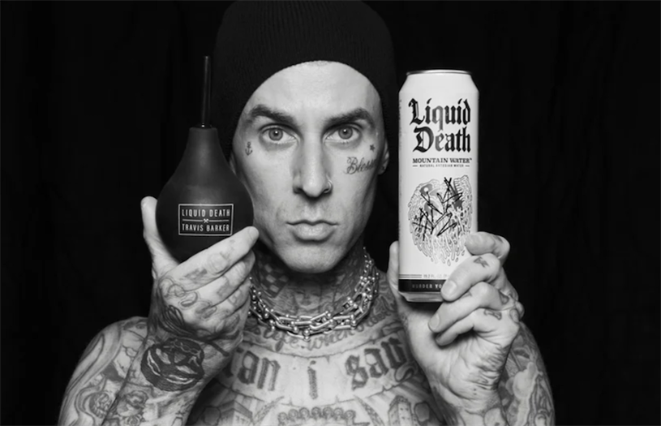
Key Takeaways
Liquid Death’s strong brand identity but challenges with accessibility & perception
Edgy & viral marketing tactics make it stand out
Opportunities for growth:
Improve retail presence
Enhance health-related branding
Expand collaborations beyond niche markets
Notes:
Liquid Death is not just a water brand—it’s a lifestyle, a movement, and an experience.
Its strong brand identity has helped it stand out, but challenges like price perception, accessibility, and broader appeal remain.
The marketing strategy should focus on viral, humorous, and rebellious content to sustain engagement.
Expanding influencer collaborations and leveraging unconventional partnerships will strengthen brand presence.
Ultimately, Liquid Death must continue to disrupt the industry, keep sustainability cool, and never play it safe.

Slide 15


Execution Plan
Increase retail partnerships for better accessibility
Diversify influencer partnerships for broader appeal
Continue humor-based, rebellious, and viral campaigns
Notes:
Alright, what’s next? More Liquid Death. Everywhere.
Step 1: Get into more stores. More convenience = more sales. Right now, we’re cool, but not always easy to find. That needs to change.
Step 2: Level up influencer collabs. Less extreme sports, more wild personalities. Think comedians, tattoo artists, underground musicians—anyone who screams rebellion.
Step 3: Keep marketing insane. Viral stunts, TikTok filters, maybe even a “Funeral for Plastic” event. The goal? Make hydration entertaining.
Bottom line: Stay bold, stay weird, and NEVER play it safe. The second we get boring, we lose. Let’s keep murdering thirst and making waves.

Slide 16
Thank You!
Questions?

